Slide 1

Intelligent Agents for Conduct Investigations
Transforming conduct investigations through AI-powered agents at every stage—from intake to resolution. These intelligent systems streamline workflows, ensure compliance, and deliver consistent outcomes.

Slide 2


Intake & Initial Assessment
Smart Intake Agent
Conflict Check Agent
Auto-classifies reports, extracts key entities, assigns severity scores, and routes to appropriate investigation queues.
Scans for conflicts of interest amongst investigators and suggests alternatives when needed.
Evidence Gathering Agent
Automatically pulls employee records, communications, and transaction data before investigation begins.

Slide 3
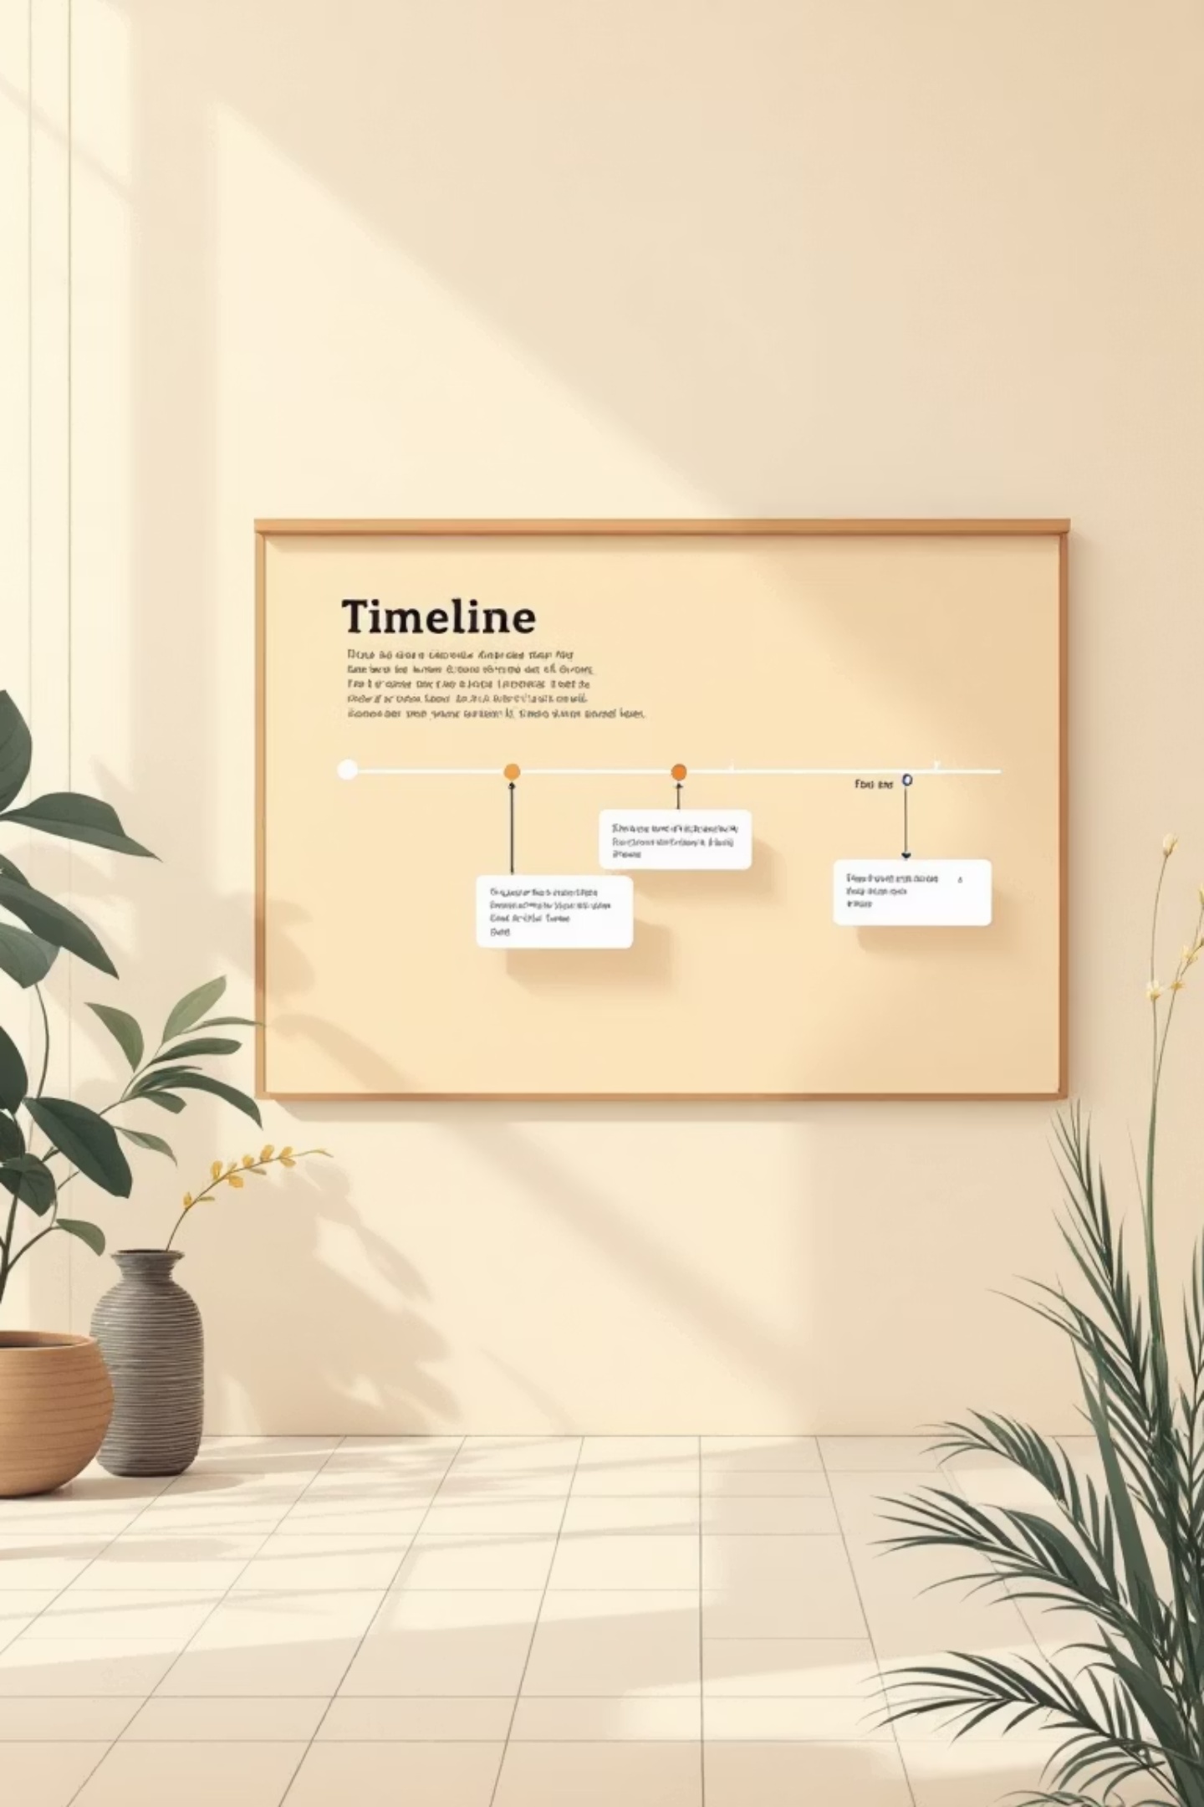
Building the Investigation Foundation
Timeline Builder Agent
Document Analysis Agent
Constructs chronological timelines from disparate sources
Performs semantic search across thousands of documents
Identifies gaps in information
Identifies similar past cases
Highlights critical dates relative to alleged conduct
Flags privileged communications

Slide 4



Investigation Workflow Intelligence
Interview Management
Schedules interviews, generates question templates, transcribes recordings, and flags inconsistencies.
Communication Patterns
Maps email networks, detects unusual patterns, and identifies knowledge holders.

Slide 5
Decision Support Systems
Precedent Research Agent
Regulatory Guidance Agent
Sanctions Recommendation
Finds similar historical cases, shows outcomes and disciplinary actions, ensuring consistency.
Identifies applicable regulations, summarises guidance, and flags mandatory reporting requirements.
Suggests appropriate disciplinary actions based on severity, precedent, and mitigating factors.

Slide 6
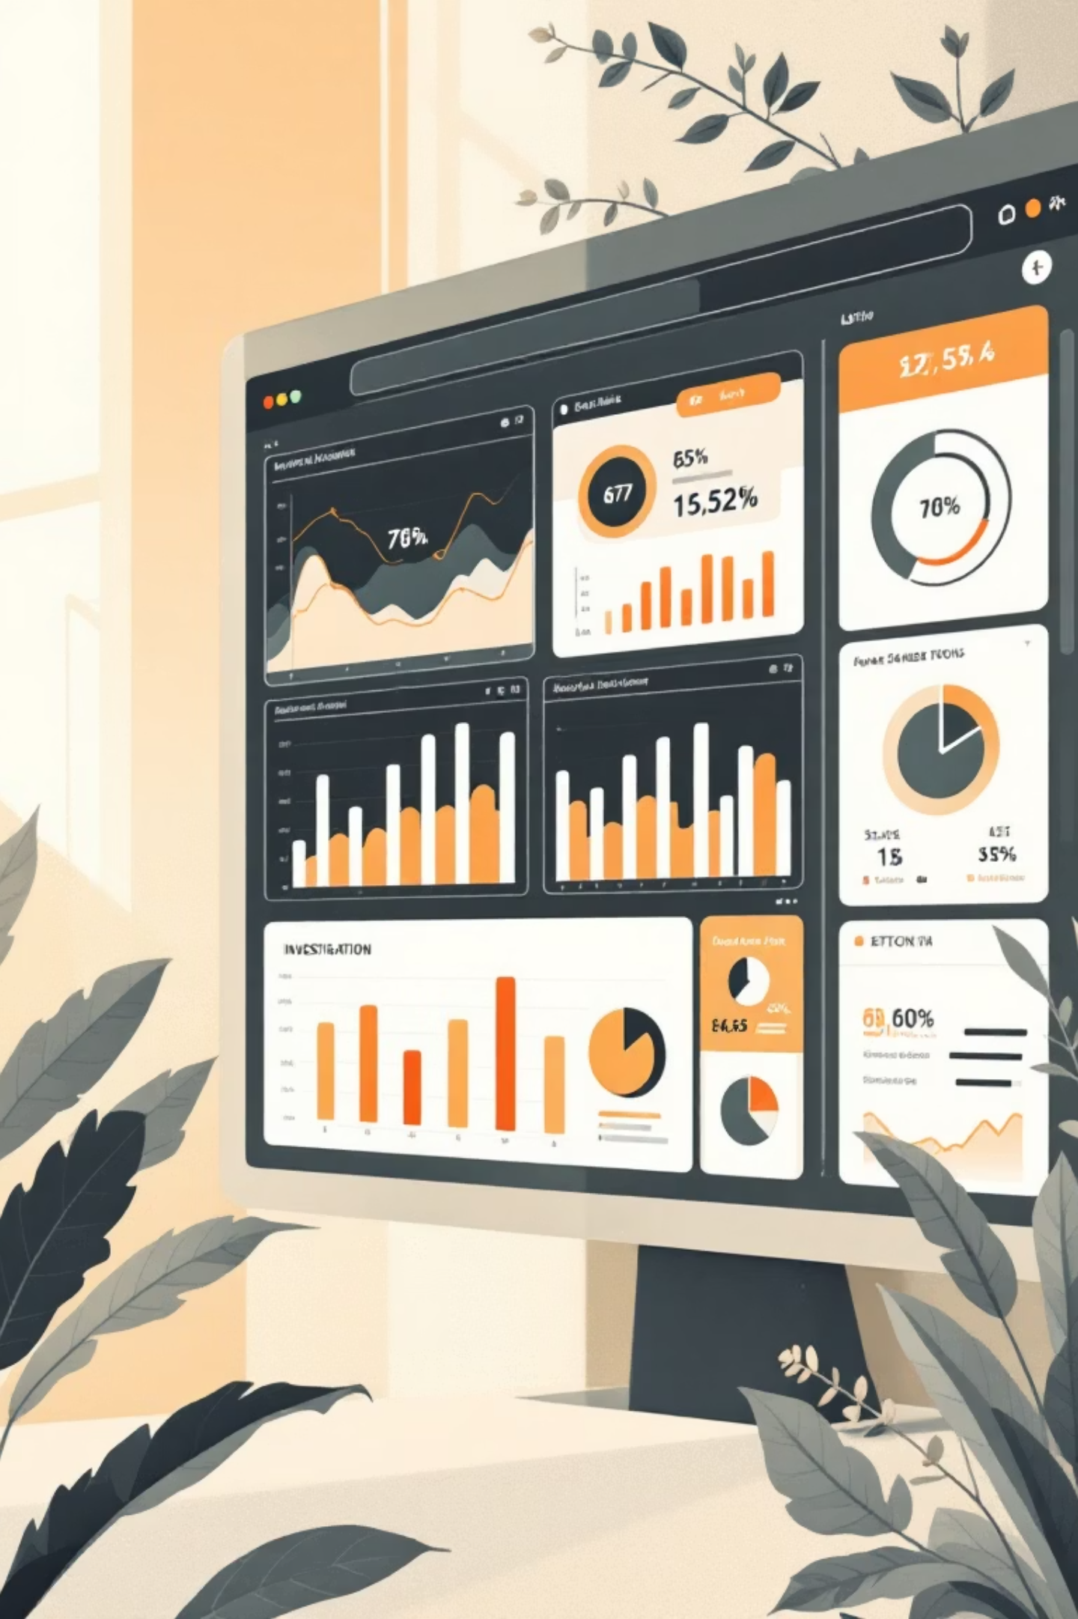
Real-Time Collaboration & Tracking
1
2
Case Status Dashboard
Escalation Management
Provides real-time updates on open investigations, alerts on deadlines, and tracks investigator workload.
Monitors escalation triggers, notifies senior management automatically, and tracks acknowledgements.
3
Stakeholder Communication
Drafts updates for various audiences, ensures confidentiality, and tracks all communications.

Slide 7
Quality Assurance & Compliance
Investigation Completeness
Legal Hold & Preservation
Checks all required steps are completed and flags missing evidence before closure.
Triggers automatic legal holds, ensures evidence integrity, and releases holds appropriately.
1
2
3
Remediation Tracking
Monitors implementation of corrective actions and ensures follow-up activities are completed.

Slide 8
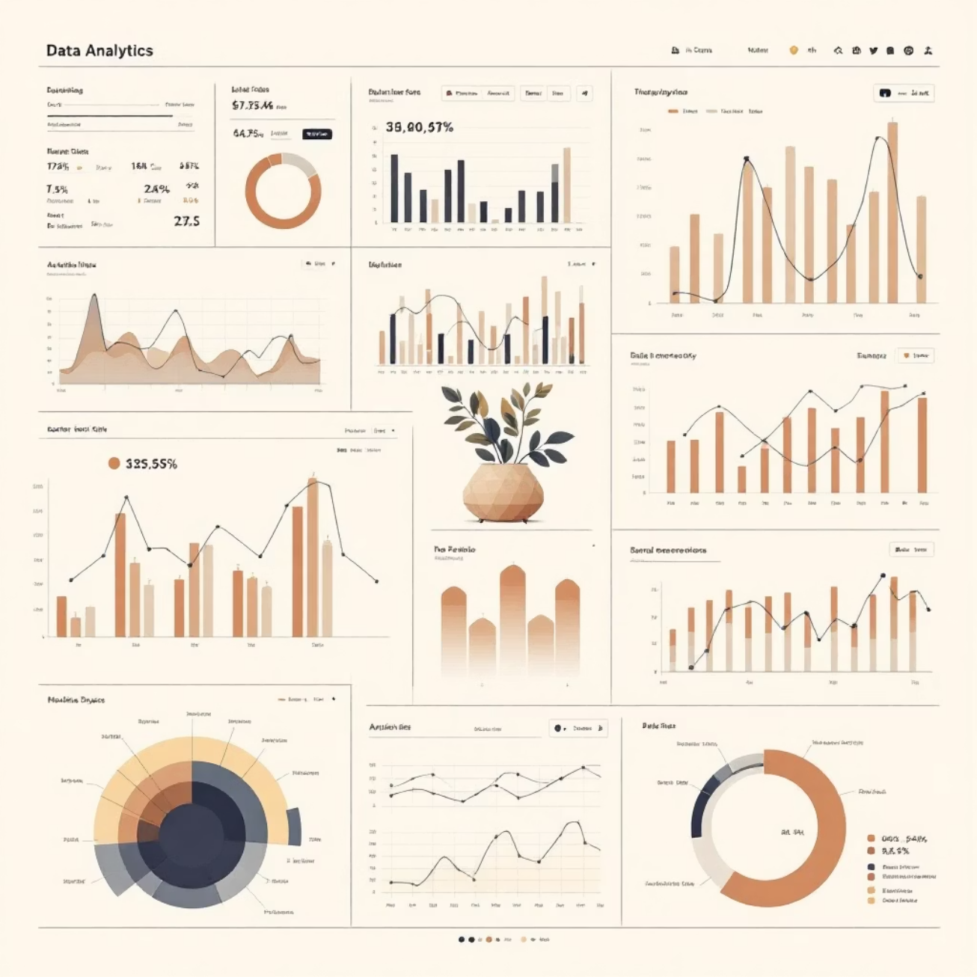
Analytics Driving Insights
3
Key Analytics Agents
Case Metrics Agent
Tracks time-to-resolution, case volumes, and investigator productivity. Generates management dashboards.
Root Cause Analysis Agent
Identifies common factors across cases, highlights systemic issues, and recommends preventive measures.
Regulatory Reporting Compiler
Aggregates case data for periodic reports and formats according to regulatory requirements.

Slide 9

Post-Investigation Excellence
Lesson Learned Agent
Appeal Management Agent
Documents investigation process effectiveness, updates playbooks based on outcomes, and identifies training needs.
Tracks employee appeals, manages review timelines, and documents appeal outcomes and rationale.

Slide 10


Transforming Investigations with AI
20+
100%
24/7
Intelligent Agents
Compliance Coverage
Continuous Monitoring
Covering every stage of the investigation lifecycle
Ensuring regulatory requirements are met consistently
Real-time tracking and automated alerts
These AI-powered agents work together to create a comprehensive, efficient, and compliant investigation ecosystem—reducing manual effort whilst improving outcomes and consistency.

